Slide 1
SDD for programming language statements
Dr G Sudha Sadasivam

Slide 2
The symbol ‘||’ is used for concatenation.
Rules are added to show relationship between the LHS and RHS of the grammar rules – semantic rules
SDD (Syntax directed definition): CFG in which the productions are shown along with the semantic rules
S-attributed : a syntax-directed definition that uses synthesized attributes only.
L-attributed – uses synthesised and inherited attributes
If the attribute of the parent node (LHS) depends on attributes of its children (RHS) such attributes are synthesized attributes
If the attributes of the child depends on the attribute of parent node, then such a attribute is called as Inherited attribute.
Every S-attributed definition is an L-attributed definition

Slide 3
SDD for Assignment statements
SNO | Production | Semantic Rule
1. | SL 🡪 SL S | S | SL.code = SL1.code || S.code SL.code = S.code
2. | S 🡪 id := E; | S.place = id.place S.code = E.code || S.place := E.place
3. | E 🡪 E+T | E - T | T | E.place = NewTemp() E.code = E1.code || T.code || E.place = E1.place+T.place E.place = NewTemp() E.code = E1.code || T.code || E.place = E1.place - T.place E.place = T.place E.code = T.code

Slide 4
4. | T 🡪 T1*F | T1/F | F | T.place = NewTemp() T.code = T1.code || F.code || T.place = T1.place*F.place T.place = NewTemp() T.code = T1.code || F.code || T.place = T1.place / F.place T.place=F.place T.code=F.code
5. | F 🡪 (E) | id | constant | F.place=E.place F.code=E.code F.place=id.place F.code=”” F.place = NewTemp() F.code =“” F.place= constant.value

Slide 5
SDD for Declaration Statements
SNO | Production | Semantic Rules
1. | decl_list 🡪 decl_list decl
2. | | decl
3. | decl 🡪 dtype id_list | id_list.type = dtype.category
4. | dtype 🡪 INT | dtype.category = INT
5. | | CHAR | dtype.category = CHAR
6. | | FLOAT | dtype.category = FLOAT
7. | id_list 🡪id_list1, ID | id_list1.type = id_list.type add_to_symboltable(ID.place,id_list.type)
8. | ID | add_to_symboltable(ID.place,id.list.type)

Slide 6
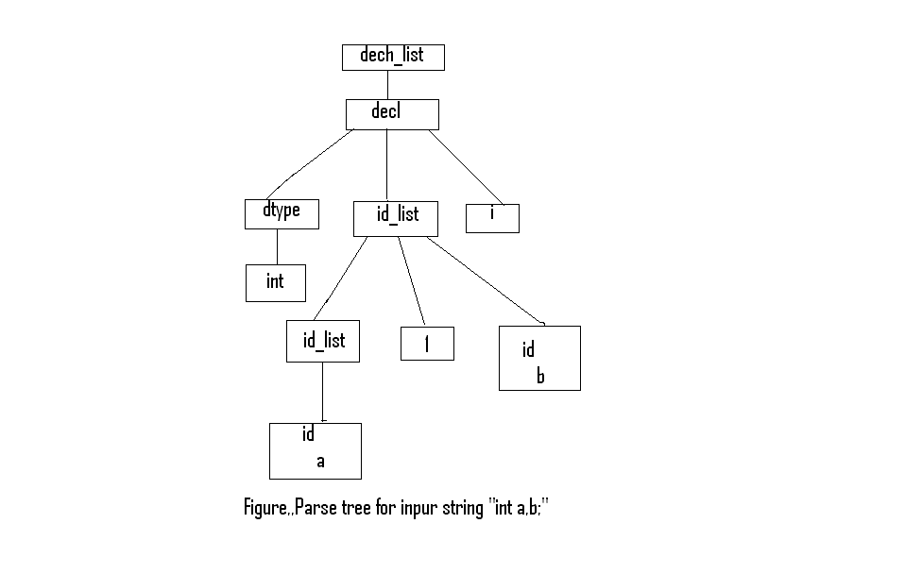
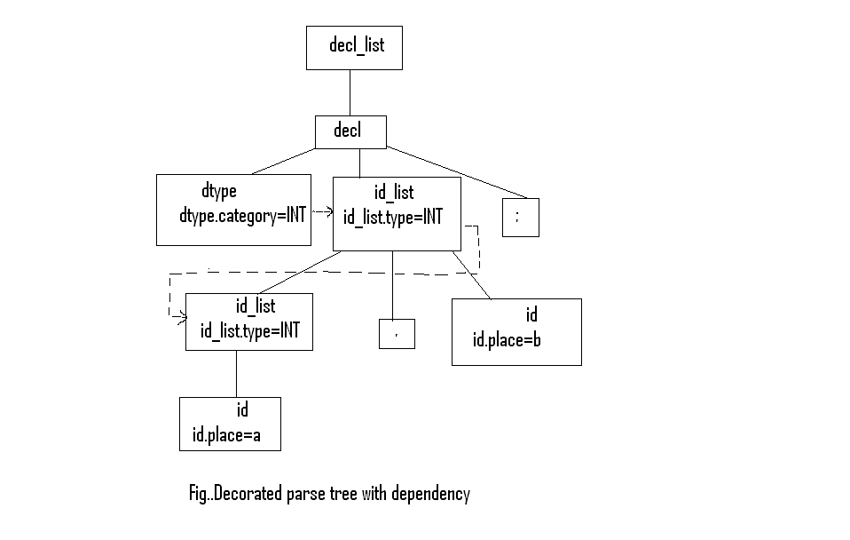
int a,b;
sibling
parent

Slide 7
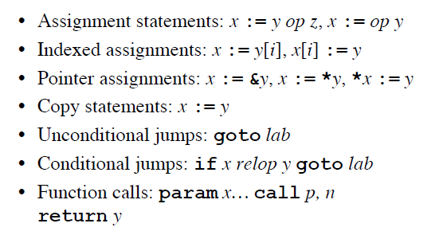
TAC
a) param x | ‘x’ is the argument of procedure call
b) call p,n | Calls procedure ‘p’ with ‘n’ parameters.
c) enter n | To store n bytes of variable in stack
d) exit n | To restore stack pointer to reclaim its ‘n’ bytes.
e) return y | Returns x and claim values from the stack
f) retrieve | Save the return value from the procedure into x.

Slide 8
SDD for simple declaration statements
CFG Semantic actions
P 🡪 DL { offset = 0 } DL
DL 🡪 DL1 D | D
D 🡪 T id_list;
id_list 🡪 id_list, id | id
D 🡪 T id; { enter(id.name, T.type, offset);
offset = offset + T.width }
T 🡪 integer { T.type = integer;
T.width = 4 }
T🡪real { T.type = real;
T.width = 8 }
T 🡪 array [ num] of T₁ { T.type = array(num.val,T₁.type);
T.width = num.val x T₁.width }
T 🡪 ↑ T₁ { T.type = pointer(T₁.type);
T.width = 4 }
enter(name,type,offset): creates a new entry for the name (var) in the symbol table. It places the type and the offset of elements within the table

Slide 9
SDD for Assignment statements
SNO | Production | Semantic Rule
1. | SL 🡪 SL S | S | SL.code = SL1.code || S.code SL.code = S.code
2. | S 🡪 id := E; Gen (id.Place: =E.Place) | S.place = id.place S.code = E.code || S.place := E.place
3. | E 🡪 E+T Gen (E.Place = E(1).Place + E(2).Place) | E – T Gen (E.Place = E(1).Place - E(2).Place) | T | E.place = NewTemp() E.code = E1.code || T.code || E.place = E1.place+T.place E.place = NewTemp() E.code = E1.code || T.code || E.place = E1.place - T.place E.place = T.place E.code = T.code

Slide 10
4. | T 🡪 T1*F Gen (E.Place = E(1).Place * E(2).Place) | T1/F Gen (E.Place = E(1).Place / E(2).Place) | F | T.place = NewTemp() T.code = T1.code || F.code || T.place = T1.place*F.place T.place = NewTemp() T.code = T1.code || F.code || T.place = T1.place / F.place T.place=F.place T.code=F.code
5. | E🡪 -E ⁽¹⁾ Gen (E.Place = - E(1).Place) | { T = NewTemp() E.Place = T E.Code = E⁽¹⁾.Code() ||E.Place = -E⁽¹⁾.Place }
6. | F 🡪 (E) | id | constant | F.place=E.place F.code=E.code F.place=id.place F.code=”” F.place = NewTemp() F.code =“” F.place= constant.value

Slide 11
SDT for a:=b*(c+d)
Input | Stack | Place | Generated Code
a := - b * (c+d)$ | $
:= - b* (c+d)$ | $id | a
- b* (c+d)$ | $id:= | a__
b* (c+d)$ | $id:= - | a__ __
* (c+d)$ | $id:= - id | a__ __b
* (c+d)$ | $id:= - E | a__ __b | T1 = -b
* (c+d)$ | $id:= E | a__ T1
(c+d)$ | $id:= E * | a__ T1 __
c+d)$ | $id:= E * ( | a__ T1 __ __
+d)$ | $id:= E * ( id | a__ T1 __ __ c
+d)$ | $id:= E * ( E | a__ T1 __ __ c
d)$ | $id:= E * ( E + | a__ T1 __ __ c __
)$ | $id:= E * ( E + id | a__ T1 __ __ c __d
)$ | $id:= E * ( E + E | a__ T1 __ __ c __d | T2 = c + d
)$ | $id:= E * ( E | a__ T1 __ __ T2
$ | $id:= E * ( E ) | a__ T1 __ __ T2__
$ | $id:= E * E | a__ T1 __ T2 | T3 = T1 * T2
$ | $id:= E | a__ T3 | a := T3
$ | $A | a | accept

Slide 12
SDD for mixed mode assignment statements
If E ⁽¹⁾.Mode = int AND E ⁽²⁾.Mode = int
/* both expressions on the RHS are of int type. So no need for type conversions*/
{
Gen (T: = E ⁽¹⁾. Place int_op E ⁽²⁾. Place)
}
else if E ⁽¹⁾.Mode = real AND E ⁽²⁾.Mode = real
/* both expressions on the RHS are of real type. So no need for type conversions*/
{
Gen (T = E ⁽¹⁾. Place real_op E ⁽²⁾.Mode = real)
}

Slide 13
else if E⁽¹⁾.Mode = int AND E⁽²⁾.Mode = real
/* expression1 on the RHS are of int type, where as expression 2 is of type real. So expression 1 has to be converted to real and the result mode should be made real.*/
{
v = NewTemp()
Gen (v = int_to_real E ⁽¹⁾. Place)
Gen (t = v real_op E ⁽²⁾. Place)
E.Mode = real
}
else if E ⁽¹⁾.Mode = real AND E ⁽²⁾.Mode = int
{
v = NewTemp()
Gen (v = int_to_real E ⁽²⁾. Place)
Gen (t = v real_op E ⁽¹⁾. Place)
E.Mode = real
}

Slide 14
x = y + i * j. Here x and y are real, whereas i and j are integers
t1 = i int* j
t2 = inttoreal t1
t3 = y real+ t2
x = t3
x = A[y,z] A is a 10 x 20 array with lower bounds 0 and 0 --TAC.
t1 = y * 20 // offset until previous row
t1 = t1 + z // offset of element within the row
t2 = c /* array start address*/
t3 = 4 * t1 // each array element is of size 4
t4 = t2[t3] // offset with start address
x = t4.

Slide 15
l-value of the assignment variable or name (L) has two attributes
L.place that is a pointer to the symbol table entry for that name.
L.offset is set to null for a simple variable. Otherwise it is an array. (assignment is for a particular array element)
E -- > L
{ if L.offset = null then
E.place = L.place
else {
E.place = newtemp;
emit(E.place = L.place [L.offset]);
}

Slide 16
L 🡪 Elist ]
For each dimension, the offset of the array is incremented by the width of the dimension given by width(Elist.array)
{ L.place = newtemp;
L.offset = newtemp;
emit(L.place = c(Elist.array));
emit(L.offset = Elist.place * width(Elist.array))
}
Elist -- > id [ E
When we consider the first dimension of the array, Elist.place is initialized to E.place.
{ Elist.array = id.place;
Elist.place = E.place;
Elist.ndim = 1 }

Slide 17
E.place holds both the value of the expression E and the value of the dimension ‘m’.
When the second dimension is encountered, Elist.ndim (which gives the number of dimensions) is incremented by 1.
Its offset is also incremented by the width of the dimension.
Elist -- > Elist₁ , E
{ t = newtemp;
m = Elist₁.ndim + 1
emit(t = Elist₁.place * limit(Elist₁.array,m));
emit(t = t + E,place);
Elist.array = Elist₁.array;
Elist.place = t;
Elist.ndim = m; }

Slide 18
SDD for Boolean Expressions
E -- > E or E | E and E | not E | (E) | id | id relop id.
x = a or b and c
t1 = b and c
t2 = a or t1
x = t2
x = a or b and not c
t1 = not c
t2 = b and t1
t3 = a or t2
x = t3
if a<b then 1 else 0
1. If a<b goto 4
2. T1 = 0
3. goto 5
4. T1 = 1
5.

Slide 19
NextQuad indicates the next entry in the quadruple array.
Gen increments the NextQuad after producing a quadruple
1) E -- > E ⁽¹⁾ or E ⁽²⁾
Gen (E.Place = E(1).Place or E(2).Place)
{ T = NewTemp();
E.Place = T;
E.Code = E⁽¹⁾.Code || E^{(2).}Code || E.Place = E⁽¹⁾.Place || or || E⁽²⁾.Place }
2) E -- > E ⁽¹⁾ and E ⁽²⁾
Gen (E.Place = E(1).Place and E(2).Place)
{ T = NewTemp();
E.Place = T;
E.Code = E⁽¹⁾.Code || E^{(2).}Code || E.Place = E⁽¹⁾.Place || and || E⁽²⁾.Place
}

Slide 20
3) E -- > not E ⁽¹⁾
Gen (E.Place = not E^{(1).}Place)
{ T = NewTemp()
E.Place = T
E.Code = E⁽¹⁾.Code () ||
E.Place = not E⁽¹⁾.Place
}
1. If a<b goto 4
2. T1 = 0
3. goto 5
4. T1 = 1
4) E -- > (E ⁽¹⁾)
{ E.Place = E ⁽¹⁾.Place
E.Code = E ⁽¹⁾.Code }
5) E -- > id
{ E.Place = id.Place
E.Code = null }
6) E -- > id⁽¹⁾ relop id⁽²⁾
{ T = NewTemp();
E.Place = T;
Gen (if id^{(1).}Place relop
id^{(2).}place )
Gen(goto NextQuad + 3)
Gen(T = 0)
Gen(goto NextQuad + 2)
Gen(T = 1) }

Slide 21
SDD with backpatching
p<q or r<s and t<u
100: if p<q goto 106
101: goto 102
102: if r<s goto 104
103: goto 107
104: if t<u goto 106
105: goto 107
106: …. True … portion
107: ….. False….portion
The code generated is thus a series of jump statements with the target of the jumps left unspecified. This is filled in when the actual location is found. This principle is called as backpatching

Slide 22
MakeList(i): It creates a new list containing only ‘i’ an index into the array of quadruples being generated. It returns a pointer to the list it has made.
Merge(p1,p2): It takes the list pointed to by p1 and p2, makes a single list and returns a pointer to it.
Backpatch(p,i): It makes each quadruple on the list pointed to by p take quadruple i as the target

Slide 23
E -- > E⁽¹⁾ and E⁽²⁾
E.False takes the value False when E⁽¹⁾ is False or when E⁽¹⁾ is True and E⁽²⁾ is False. Hence E⁽²⁾ is not evaluated when E⁽¹⁾ becomes false. So, E.False = Merge (E^{(1).}False, E⁽²⁾.False).
But to store E.True in true list both E⁽¹⁾ and E⁽²⁾ have to be true (ie E.True = E⁽²⁾.True).
Hence a marker terminal M is used. This tells us whether the next quadruple is to be evaluated or not.
Thus E⁽²⁾ is evaluated only when E⁽¹⁾ becomes true. This is given by Backpatch(E⁽¹⁾.True, M.Quad).
E -- > E ⁽¹⁾ and M E ⁽²⁾
{ BackPatch ( E^{(1).}True, M.Quad)
E.False = Merge (E^{(1).}False,E^{(2).}False)
E.True = E^{(2).}True
}

Slide 24
E -- > E⁽¹⁾ or E⁽²⁾
E is False, only when both E⁽¹⁾ and E⁽²⁾ are False. So it is given by E.False = E⁽²⁾.False.
Hence, E⁽²⁾ is evaluated when E⁽¹⁾ is false. It is given by, Backpatch(E^{(1).}False,M.Quad).
E can be true when either E⁽¹⁾ or E⁽²⁾ is true ie, E.True = Merge (E^{(1).}True, E⁽²⁾.True).
E -- > E ⁽¹⁾ or M E ⁽²⁾
{ BackPatch ( E^{(1).}False, M.Quad)
E.True = Merge (E^{(1).}True,E^{(2).}True)
E.False = E^{(2).}False }

Slide 25
3) E -- > not E ⁽¹⁾ { E.False = E^{(1).}True
E.True = E^{(1).}False
}
4) E -- > (E ⁽¹⁾) { E.True = E^{(1).}True
E.False = E^{(1).}False
}
5) E -- > id { E.True = MakeList(NextQuad)
E.False = MakeList (NextQuad+1)
Gen(if id.Place goto __)
Gen (goto __)
}

Slide 26
6) E -- > id⁽¹⁾ relop id⁽²⁾ { E.True = MakeList(NextQuad)
E.False = MakeList (NextQuad+1)
Gen(if id⁽¹⁾.Place relop id⁽²⁾.Place
goto __)
Gen (goto __)
}
7) M -- > ε
{ M.Quad = NextQuad }
The problem that arises when we produce code bottom-up is that the actual quadruples to which the jumps are made may not have been generated at the time the jump statement was generated.

Slide 27
SDD for Control Flow Statements
Code for E
Code for E
M⁽¹⁾
Code for E
Code for S⁽¹⁾
Code for S⁽¹⁾
TRUE:
Code for S
TRUE:
M⁽¹⁾
TRUE:
M
M⁽²⁾
Code for S⁽²⁾
goto
FALSE:
M⁽²⁾
N
S 🡪 while M⁽¹⁾E do M⁽²⁾S⁽¹⁾
a) If Statement
b) If–then-elseStatement
c) While Statement
if E then M S⁽¹⁾
if E then M⁽¹⁾S⁽¹⁾ N else M⁽²⁾S⁽²⁾

Slide 28
3) S🡪→ if E then M⁽¹⁾S⁽¹⁾ N
else M⁽²⁾S⁽²⁾ { BackPatch(E.True, M⁽¹⁾.Quad)
BackPatch(E.false, M⁽²⁾.quad)
S.Next= Merge(S⁽¹⁾.Next, N.Next,
S⁽²⁾.Next)
}
4) S -->🡪 if E then M S⁽¹⁾ { BackPatch(E.True, M.Quad)
S.Next =Merge(E.False, S⁽¹⁾.Next)
}
5) S → while M⁽¹⁾E
do M⁽²⁾S⁽¹⁾ { BackPatch(S^{(1).}Next,M^{(1).}Quad)
BackPatch(E.True,M⁽²⁾.Quad)
Gen(goto M(¹⁾.Quad)
}

Slide 29
1) M -->🡪 ε { M.Quad=NextQuad }
2) N--> 🡪 ε { N.NEXT= MakeList(NextQuad)
Gen(goto __) }
N- is a marker terminal which indicates the jump after S^{(1).}

Slide 30
if ( a<b or c <d) x := y+z;
if a < b then goto (4)
if c < d then goto (4)
goto (6)
t0 = y+z
x = t0
6.
if (v1 < v2) { v3 = 10; }
else if ( v1 > v2) {v3 = 20; }
else if (v1 ==v2) { v3 = 30; }
v4 = 89;
100: if (v1< v2) goto 102
101: goto 104
102: v3 = 10;
103: goto 111
104: if (v1> v2) goto 106
105: goto 108
106: v3 = 20;
107: goto 111
108: if (v1 == v2) goto 110
109: goto 111
110: v3 = 30
111: v4 = 89

Slide 31
while ( i>0)
{
val = val * i;
i = i – 1;
}
x = 0;
TAC:
100: if i > 0 goto 102
101: goto 107
102: t1 = val * i
103: val = t1
104: t2 = i -1
105: i = t2
106: goto 100
107: x = 0
int h, a[20];
h = 30;
a1[10]=h;
h = a1[15];
The TAC generated is
h = 30
t1 = 10 * 4
t2 = & a1
t2[t1] = h
t3 = 15 * 4
t4 = & a1
t5 = t4[t3]
h = t5

Slide 32
SDD for procedure call statement
When a procedure call occurs, space must be allocated for the activation record of the called procedure.
The arguments of the called procedure must be evaluated and made available to the called procedure . Ptrs to be established
The state of the calling procedure should also be saved, so that it can be resumed after the call is completed. The return address of the calling procedure should also be saved. Finally a jump to the beginning of the code for the called procedure must be generated.
When the procedure returns, the result of the function should be returned.
The activation record of the calling procedure must be restored and a jump to the calling procedure’s return address must be generated.

Slide 33
When the procedure is called, the parameters are printed in the TAC and then the procedure call occurs. A queue is maintained for parameters.
1) S -->🡪 call id (Elist) { for each item p on queue do
emit(‘param’, p);
emit (‘call’ id.place) }
Elist -->🡪 Elist , E { append E.place to the end of
queue }
Elist -->🡪 E { initialize queue
to contain only E.place }

Slide 34
int g_v1;
void increment()
{ g_v1 = g_v1+1; }
int main()
{
int v1,v2,v3;
v1 = 10;
v2 = 20;
increment();
}
TAC:
enter 8 // code for increment()
t1 = g_v1 + 1
g_v1 = t1
exit 8
enter 16 // code for main()
v1 = 10
v2 = 20
call increment
exit 16

Slide 35
int add(int a, int b)
{
int c;
c = a+b;
return c;
}
int main()
{
int v1,v2,v3;
v1 = 10;
v2 = 20;
v3 = add(v1,v2);
}
The TAC generated is as follows:
enter 20
// code for add procedure
t1= a+b
c = t1
return c
exit 20
enter 40
// code for procedure main()
v1 = 10
v2 = 20
param v2
param v1
call add
retrieve t2
v3=t2
exit 40

Slide 36
SDD for case statements
switch E
begin
case V1 : S1
case V2 : S2
. . .
case Vn-1 : Sn-1
default : Sn
end
code to evaluate E into t
goto test
L1 : code for S1
goto next
L2 : code for S2
goto next
. . .
Ln-1 : code for Sn-1
goto next
Ln : code for Sn
goto next
test : if t = V1 goto L1
if t = V2 goto L2
. . .
if t = Vn-1 goto Ln-1
goto Ln
next :

Slide 37
Example
Switch A+B
Begin
Case 0 : A := B + 1
Case 1 : A := B + 2
Case 2 : A := B + 3
Case 5 : A := B + 6
Case 9 : A := B+10
Default : A := B
End
t0=A+B
Goto Test
l1: t1=b+1; a=t1; goto next
l2: t1=b+2; a=t1; goto next
l3: t1=b+3; a=t1; goto next
l4: t1=b+6; a=t1; goto next
l5: t1=b+10; a=t1; goto next
l6: t1=b; a=t1; goto next
Test: if (t0==0) goto l1
if (t0==1) goto l2
if (t0==2) goto l3
if (t0==5) goto l4
if (t0==9) goto l5
goto l6

Slide 38
if ( a<b or c <d) x := y+z;
if a < b then goto (4)
if c < d then goto (4)
goto (6)
t0 = y+z
x = t0
with BP
in violet without BP
if ( a<b or c <d) x := y+z;
if a < b then goto (4)
t1=0
goto 5
t1=1
if c < d then goto (8)
t2=0
goto (9)
t2=1
t3=t1 or t2
if t3 goto 13
t3=0
goto 15
t4=y+z
x = t4

